Slide 1
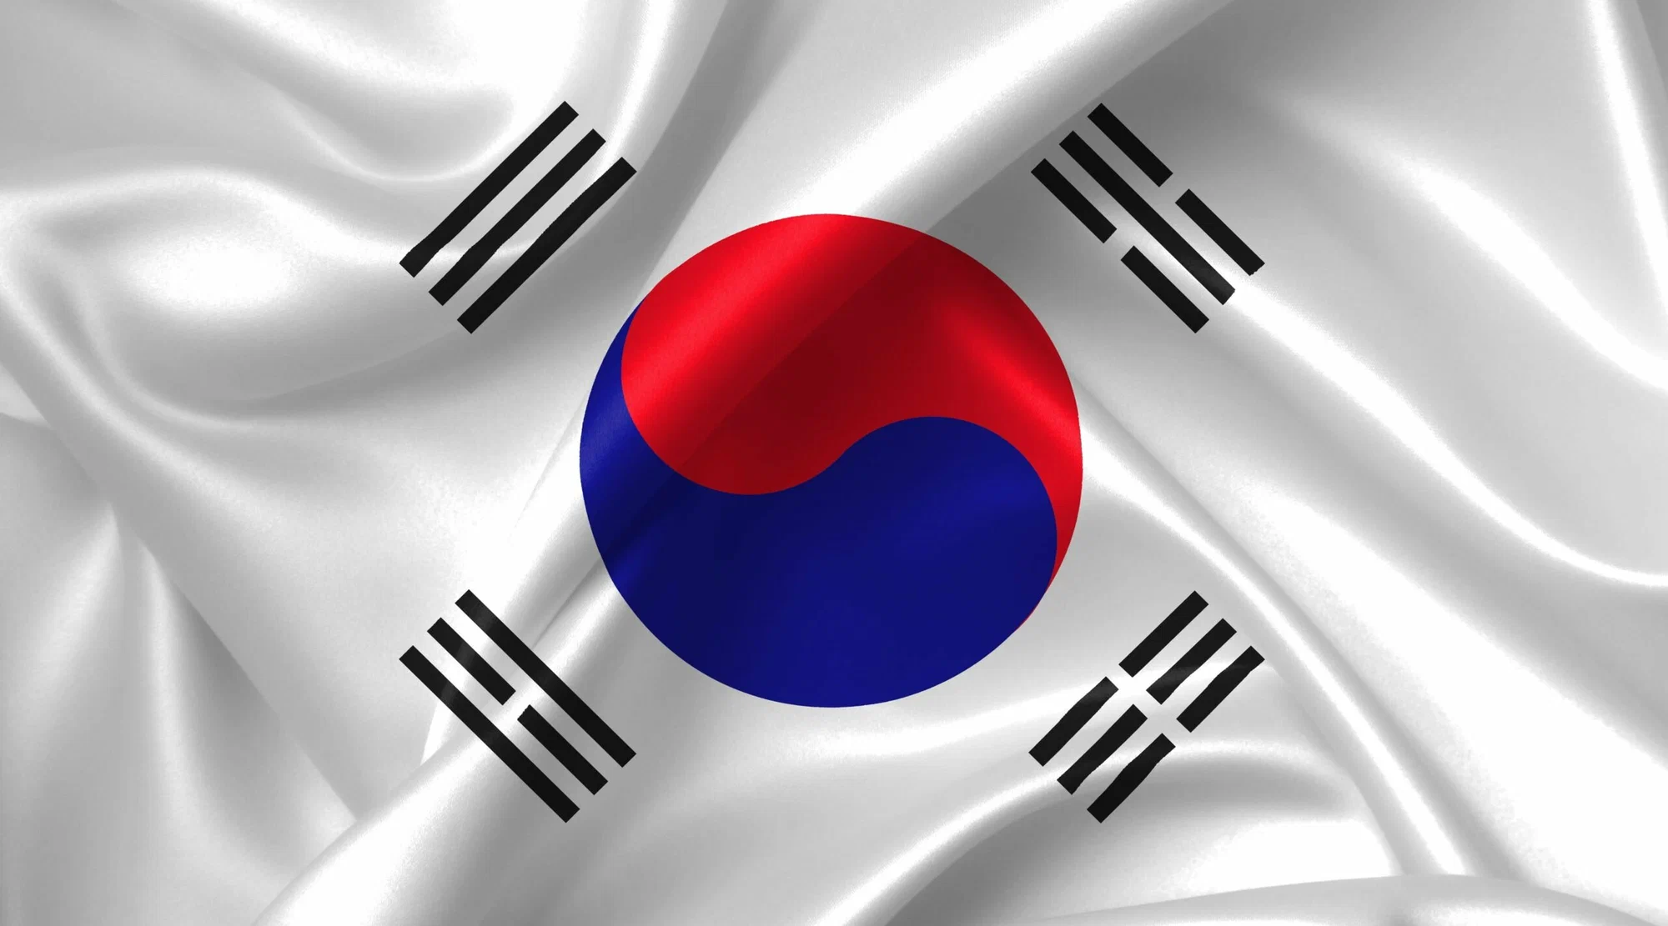
Education in South Korea

Slide 2
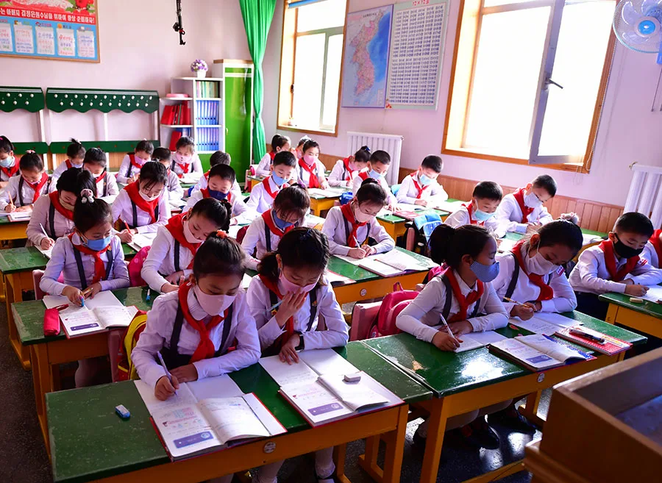
Lessons last 45 minutes.
The academic year is divided into semesters.
The first one starts in March and lasts until July.
The second semester is from August to February.
School education

Slide 3
High school
“Chodeung hakgyo”
Elementary school
For children from 6 to 12 years old.
Most subjects are taught by a single teacher.
Grades do not affect the transition from class to class: only age matters.
Middle school

Slide 4
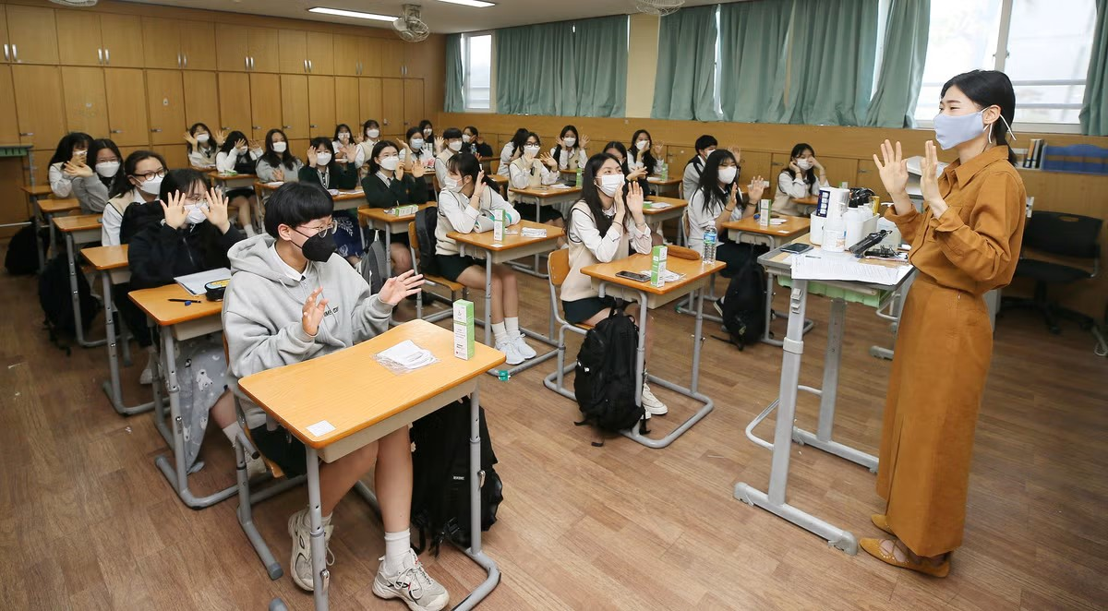
Elementary school
“Jung Haggyo”
For children from 12 to 15 years old.
Different subjects are taught by different teachers.
In middle school, more attention is paid to discipline than in elementary school.
Students are required to wear uniforms and certain hairstyles.
Middle school
High school

Slide 5
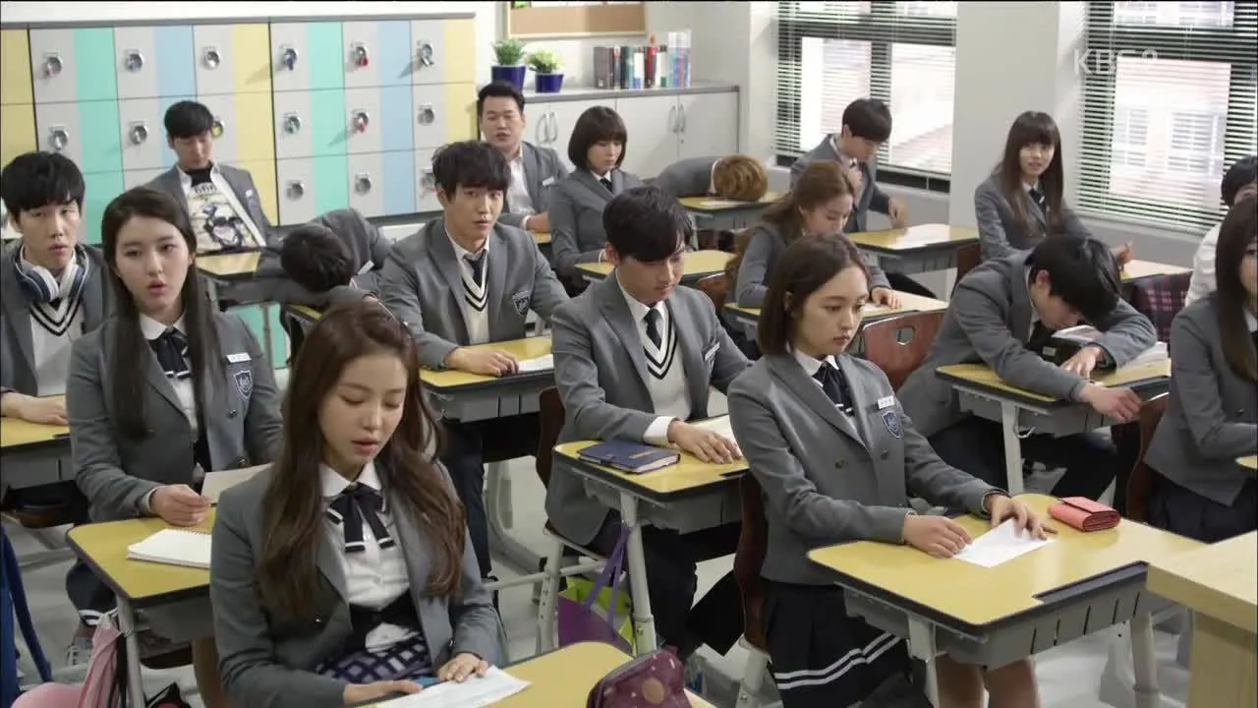
“Codyn Haggyo”
Middle school
for children from 15 to 18 years old.
This is an optional level of education, but 98% of Koreans study here.
High schools have a specialization: there are scientific, language and art schools in the country. The training program is very intensive and can include up to 11 subjects from a selected field.
The high school is fully focused on passing the final exam.
High school
Elementary school

Slide 6
Admission to universities
For Koreans
For Foreigners

Slide 7
Admission to universities
For Koreans
After graduating from high school, Korean citizens take an entrance exam for admission to a university, which consists of three parts: their native language (Korean), mathematics and English, as well as several subjects and, optionally, a second foreign language.
For Foreigners

Slide 8
Admission to universities
For Foreigners
Need to have good average score in the certificate, recommendations and a motivation letter.
Confirm the level of language proficiency — English or Korean, depending on the program (TOPIK 3 or IELTS 5.5.). But higher results will allow you to qualify for a discount.
For Koreans

Slide 9
Scholarships
For Koreans
For Foreigners

Slide 10
Scholarships
For Koreans
The Overseas Koreans Scholarship program provides four semesters of free study, an air ticket and a monthly allowance of 43,000 ₽
For Foreigners

Slide 11
Scholarships
For Foreigners
The Global Korea Scholarship program covers the costs of tuition, accommodation, insurance and flight. They also pay an allowance of 43,000 ₽ per month, and give grants of 14,150 ₽ per month.
For Koreans

Slide 12
Education fees
For Koreans
For Foreigners

Slide 13
Education fees
Education fees are the same for local and international students. On average, studying in South Korean university will cost from $1,500 to $15,000 per semester.
For Koreans
For Foreigners

Slide 14
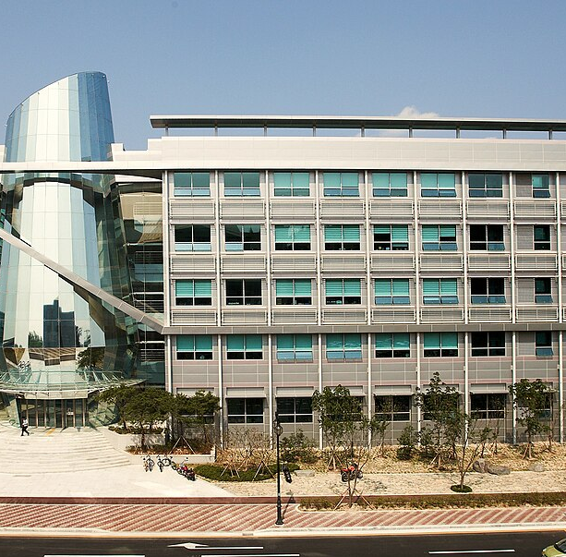
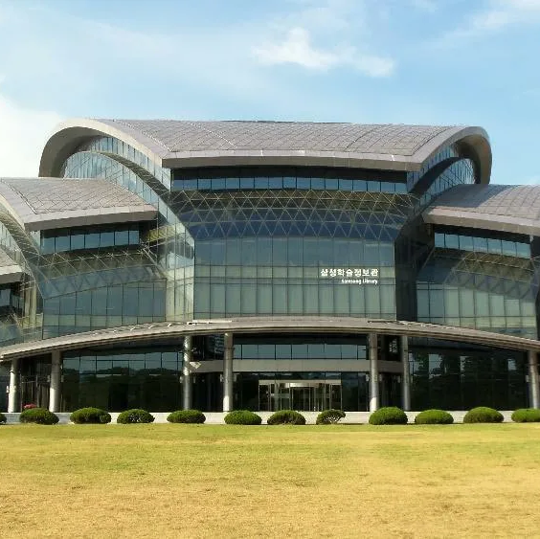
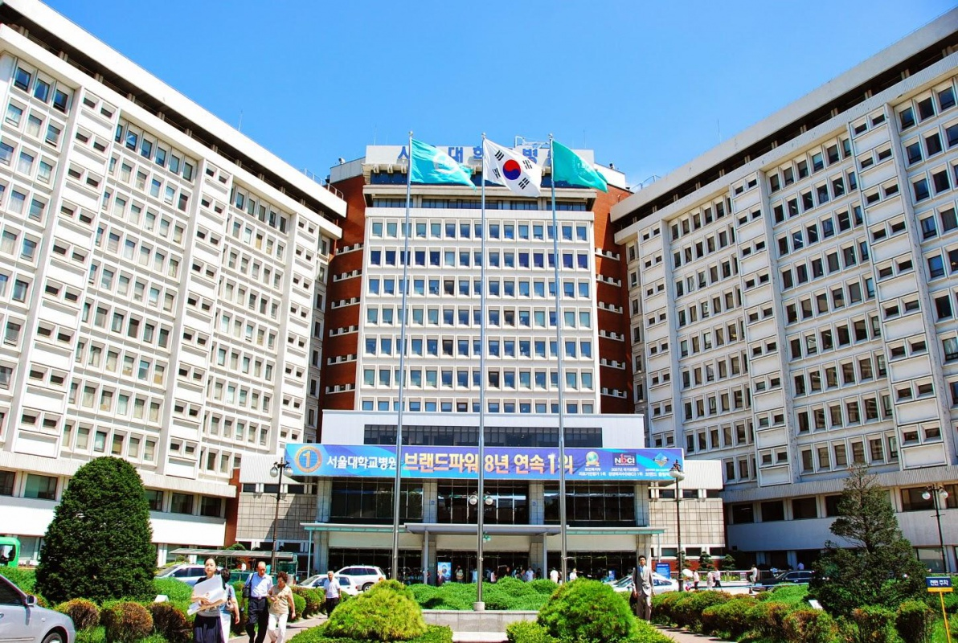
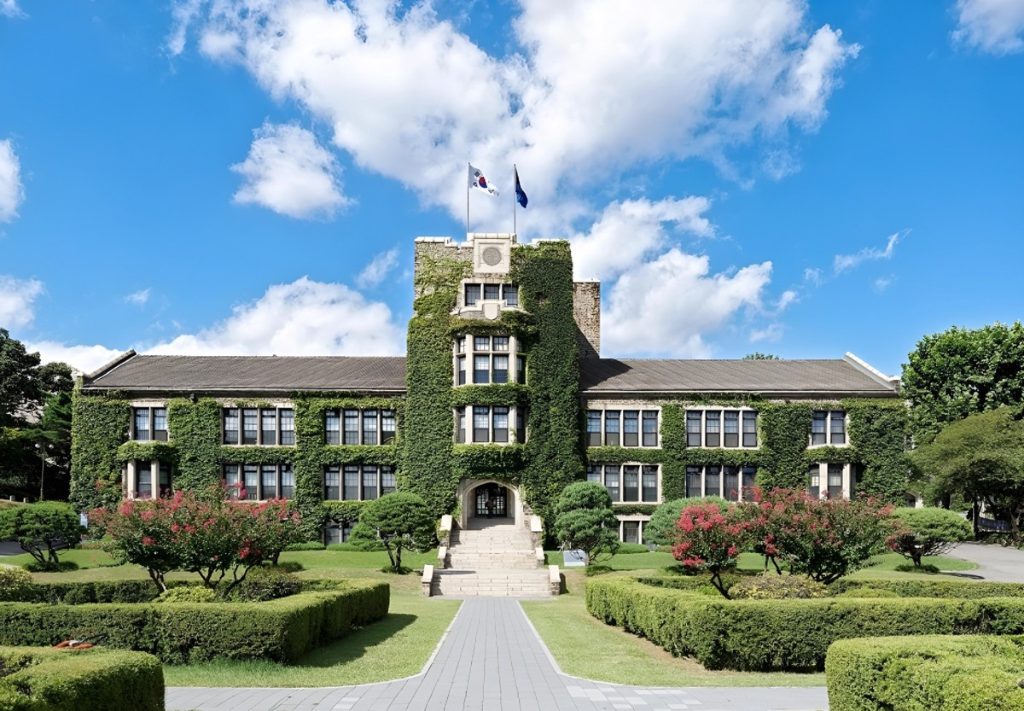
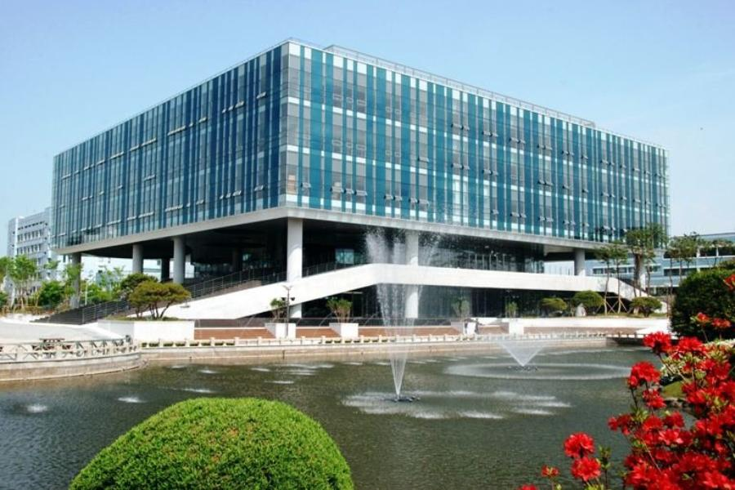
Seoul National University (SNU)
Сosts (1 semester)- from 1,700$ to 3,600$

Slide 15
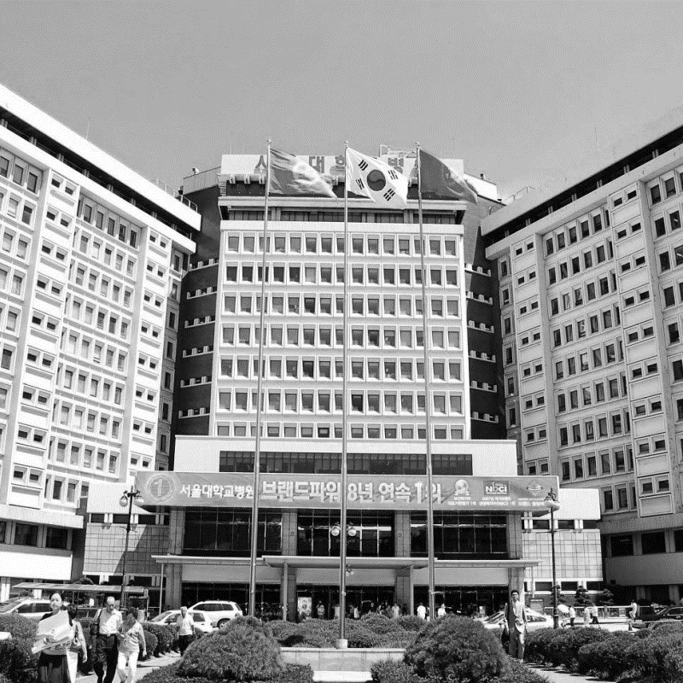
Yonsei University
Costs (1 semester) - from 2600$ to 4400$

Slide 16
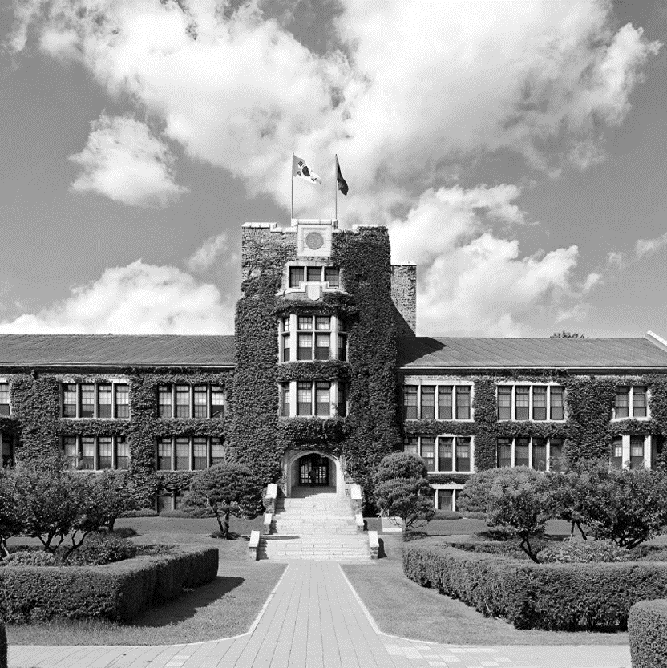
Korea Advanced Institute of Science and Technology (KAIST)
Costs (1 semester) – about 3500 $

Slide 17
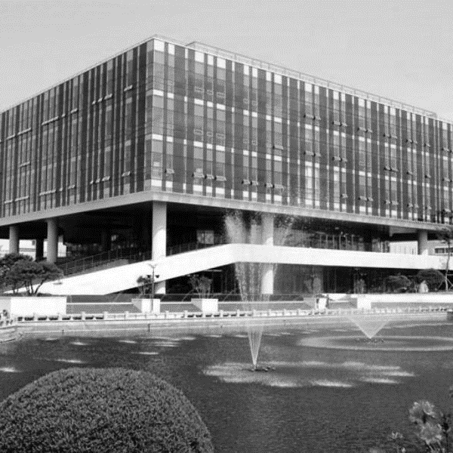
Pohang University of Science and Technology (POSTECH)
Costs (1 semester) – about 3700 $

Slide 18
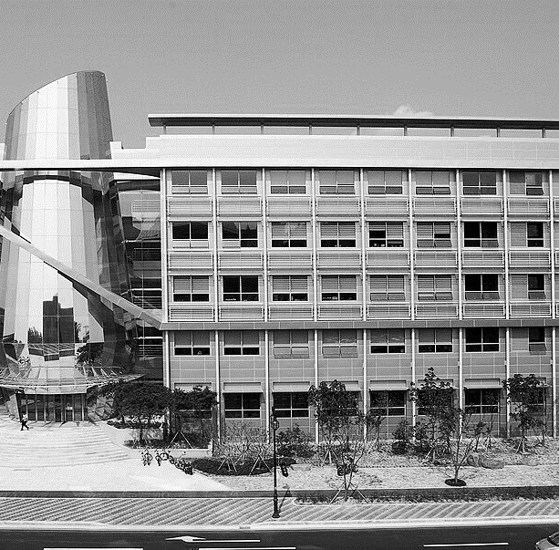
Songyungwan University
Costs (1 semester) – about 1700 $

Slide 19

Thanks for your attention!
The presentation was prepared for you by Rakhimova S. and
Shodieva Sh.

